Slide 1



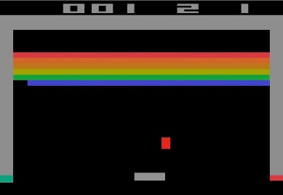
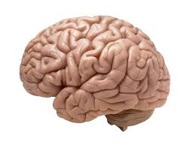

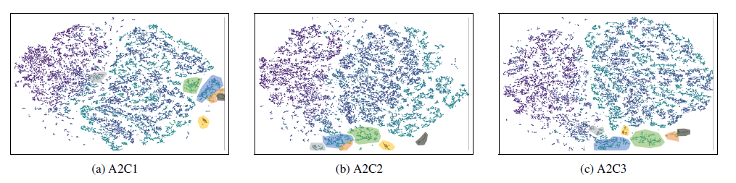
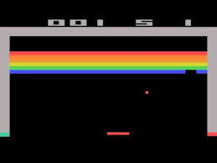

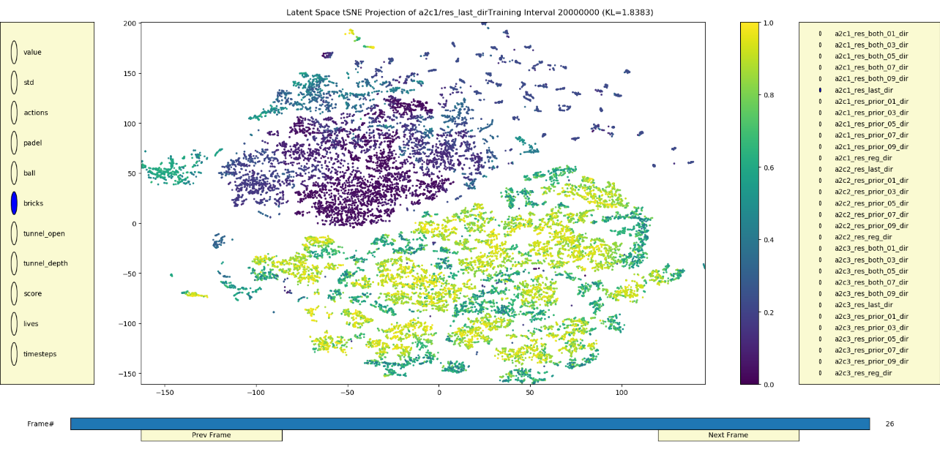

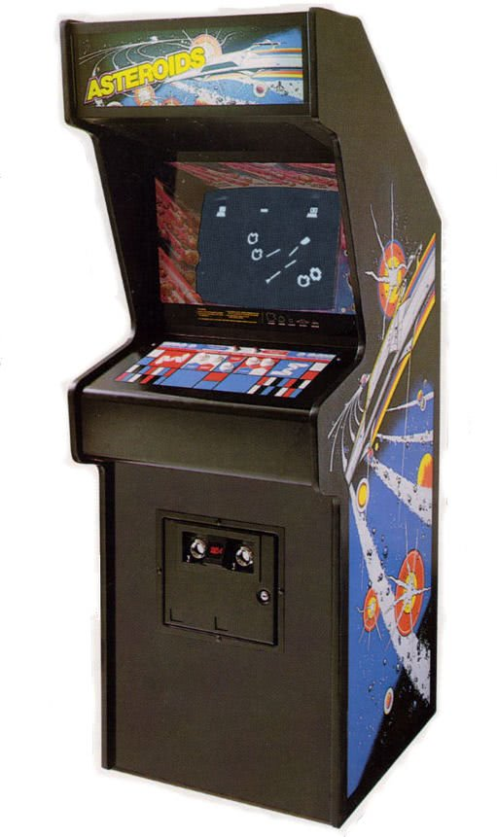
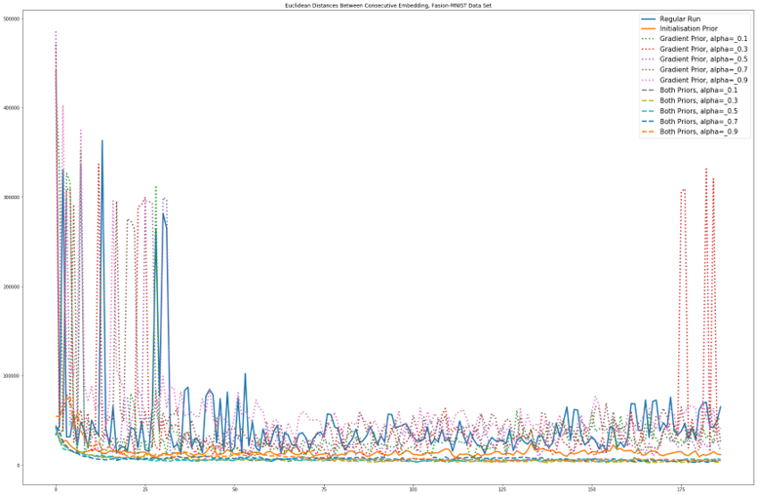
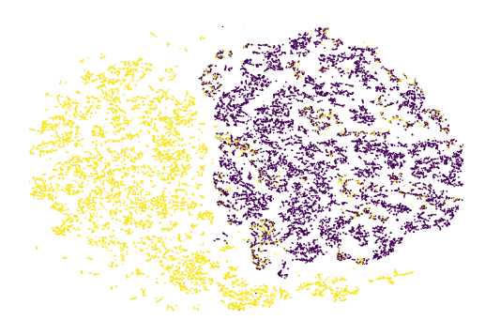


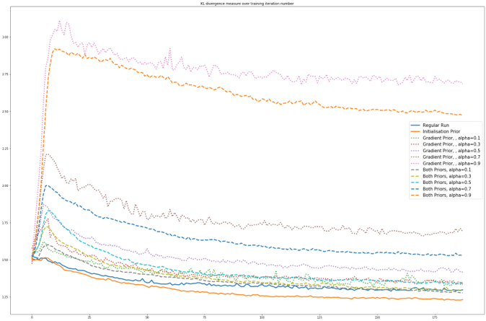

Visualization of Reinforcement Learning Agents’ Training Process Using Prior-Based Modification Of t-SNE Algorithm
Guy Shkury and Manor Zvi, Supervised by Tom Zahavy
Introduction
Agent’s Latent Space
The GUI
Train an A2C (Advanced Actor Critic) and record its network parameters every pre-defined interval size.
Collect a large set of environment states.
For each agent record, feed-forward the whole set of environment states, and save its latent space representations.
Project the latent state representations onto a 2d space using SOTA dimensionality reduction technique.
Analyze state features and relations in the 2d Euclidean space.
Deduce conclusions regards the agent’s training process such as: which skills it learns at each time.
A2C agents characterized by a single CNN (Convolutional Neural Network) with 2 heads: one for the action, and one for the value. The Algorithm uses those head to improve: the actor (action head) picks actions, and the critic (value head) tells the actor if the choice was good or bad post factum.
Both heads share the same underlying latent space
We assume this latent space embeds the state representation, as the agent perceive it.
The GUI allows us to analyze the lower dimension representations.
Each state represented as a point is the scatter plot, relations between points indicates the perception of the agent w.r.t the state. For example: all states with the ball above the breaks form a cluster of points in the scatter plot.
the bar near the bottom allow us to travel through different times during the training.
The panel on the left include a large verity of hand-crafted features to color the points such as: pedal location, bricks count, tunnel depth and more.
the panel on the right allows to choose between different agents and different versions of t-SNE.
CNN
Value Head
Underlying Layer
Action Head
We are interested in that layer output.
Goals
Gain a deep understanding about the way the agent perceive its environment at each time during training process such as:
Which skills learned at each time?
How does the agent perceive similar states with non-similar semantic meanings?
Does the training process become saturated?
t-SNE and Modified t-SNE
In addition, the tool allow to gather group of points together and watch some statistics of the group.
For more capabilities if the GUI see: https://youtu.be/j_8j7NCE10Q
t-SNE minimize the KL (Kullback-Leibler) divergence using SGD and therefore isn’t consistent in consecutive runs. KL formula is as follows: $KL(P|\left|Q\right)=\sum_{ij}{p_{ij}\log\left(\frac{p_{ij}}{q_{ij}}\right)}$ With P and Q distributions of the data in high & low dimensions w.r.t the similarities in each.
We Present 2 methods for increasing the consistency:
Initialization prior: set the initialization of any t-SNE run to the previous result
KL Prior: $KL_{t}\left(αQ_{t−1}+\left(1−α\right)P_{t}||Q_{t}\right)$
Challenges
RL agent has very non-stable training process.
Non-linear dimensionality reduction technique are stochastic and therefore are not consistent over time.
Very large amounts of data need to be collected and processed.
Results
We tasted the method on 3 independent agent.
At each one of them, the same clusters of states formed, roughly at the same time during training.
all agents clustered in early stage of the training the states with a tunnel open and the ball above the bricks.
All agents classified states w.r.t open/closed tunnel.
Agents Training
Consistency: As indicated by the sum of distances between consecutive data points positions in the 2d space
Regular t-SNE is not consistent
KL Prior is not consistent either (different α)
Initialization Prior consistent
1. Simulator generates Breakout states St
2. Based on St and Rt Agent choose actions At+1
3. Reward Signal Rt+1
Loss: Surprisingly, Initialization KL minimizes the KL target better than the regular t-SNE
Conclusions
4. Once in a time interval, record the agent parameterization
Our method proved to provide powerful insights about how an agent perceive its environment.
Based on those insight, one can design improved DRL algorithms, and better tune its hyper-parameters (such as training time).
KL Prior failed to obtain consistency between consecutive t-SNE runs, but Initialization Prior succeeded.
Regular t-SNE
KL Prior
Initialization
5. Also, collect game states for later analysis.
November 2019

